Slide 1
Enhancing Multilingual Communication through NLP and Speech Recognition Integration
Name: Pranav Dalvi
Roll No.: 04
Organisation: Kirti M. Doongursee College
Date: 13/06/2024

Slide 2
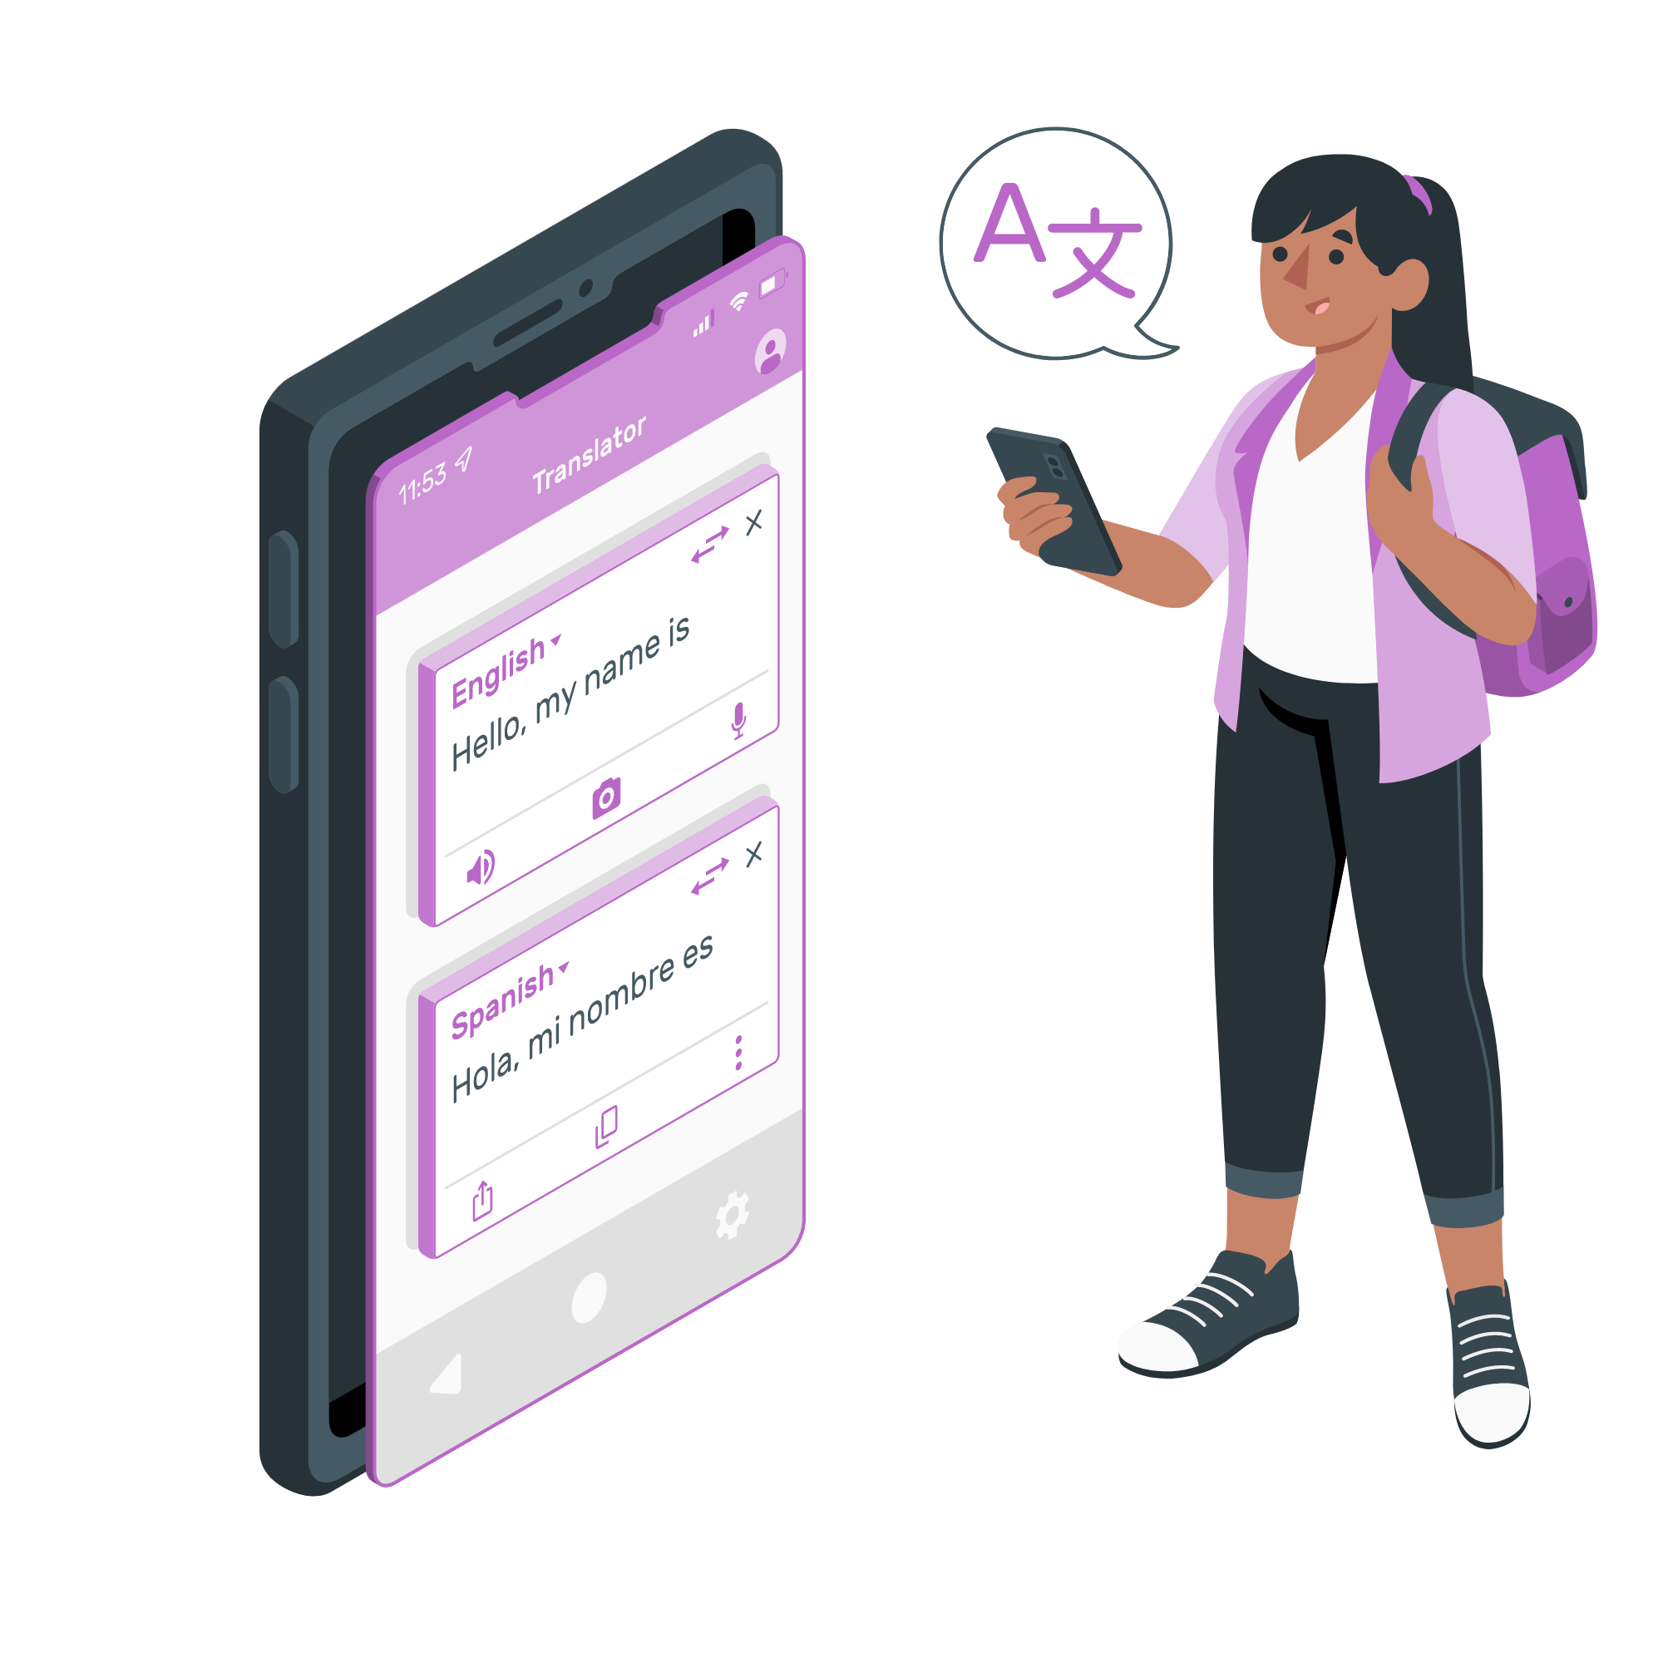
Introduction
Challenges of communication across languages
Language barriers, Cultural differences, Vocabulary limitations, Vocabulary limitations.
Advancements in NLP and Speech Recognition.
Powerful language models like spaCy, BERT, and GPT can understand and process human language with greater accuracy. NLP can analyze text sentiment, identify keywords, and even generate human-quality text.
Technologies like Google Speech Recognition allow computers to transcribe spoken language into text with high accuracy. This has revolutionized voice assistants, voice search, and dictation software.

Slide 3
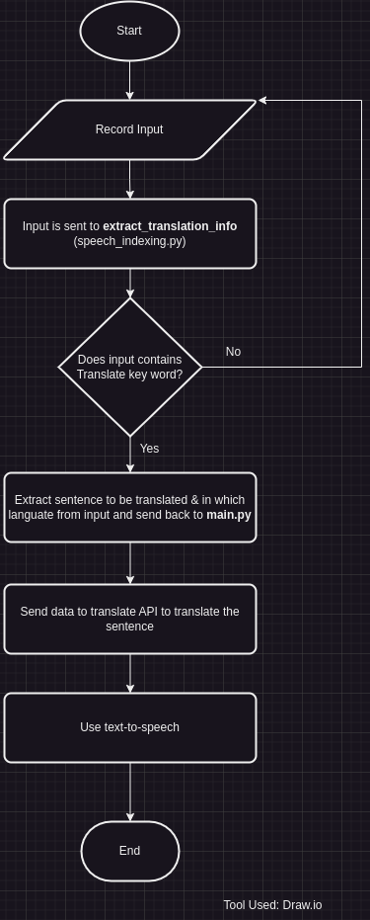
System Overview
The project integrates the speech_indexing.py module for language detection and cleaning the input with the main.py module for speech recognition and translation.
The project uses combination of spaCy for NLP tasks and Google APIs for speech recognition and translation.

Slide 4
Methodology
Language Detection and Translation Command Extraction:
Utilizes spaCy for tokenizing and analyzing the structure of input sentences.
Detects language keywords using tokenized lists of input and pre-defined lists.
Cleans the text to remove unnecessary command phrases for accurate translation using regular expressions.
Speech Recognition and Translation:
Uses the SpeechRecognition library to capture and transcribe spoken input.
Integrates Google Translate API for translating transcribed text.
Converts translated text to speech using Google Text-to-Speech (gTTS).

Slide 5
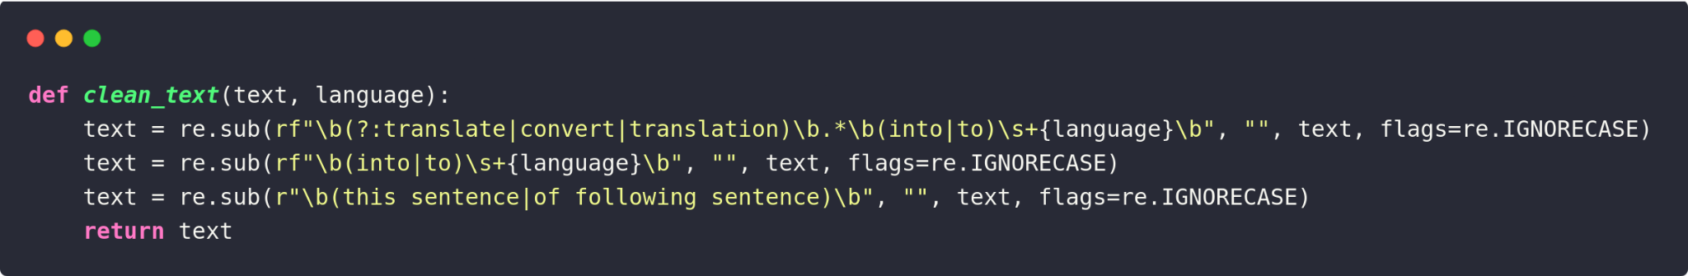
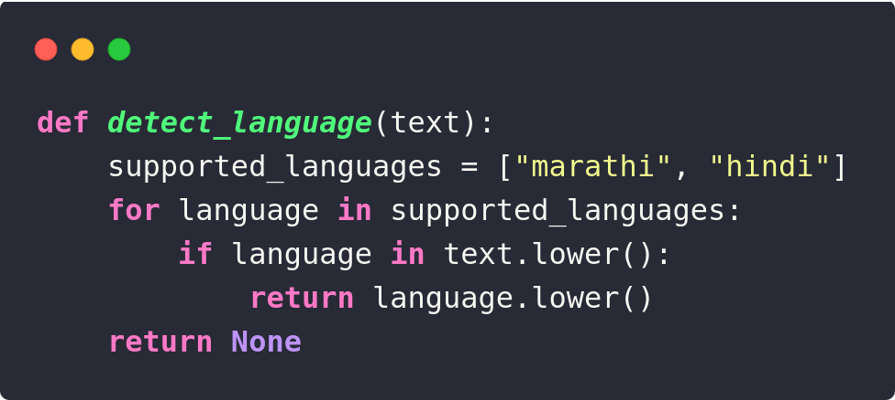
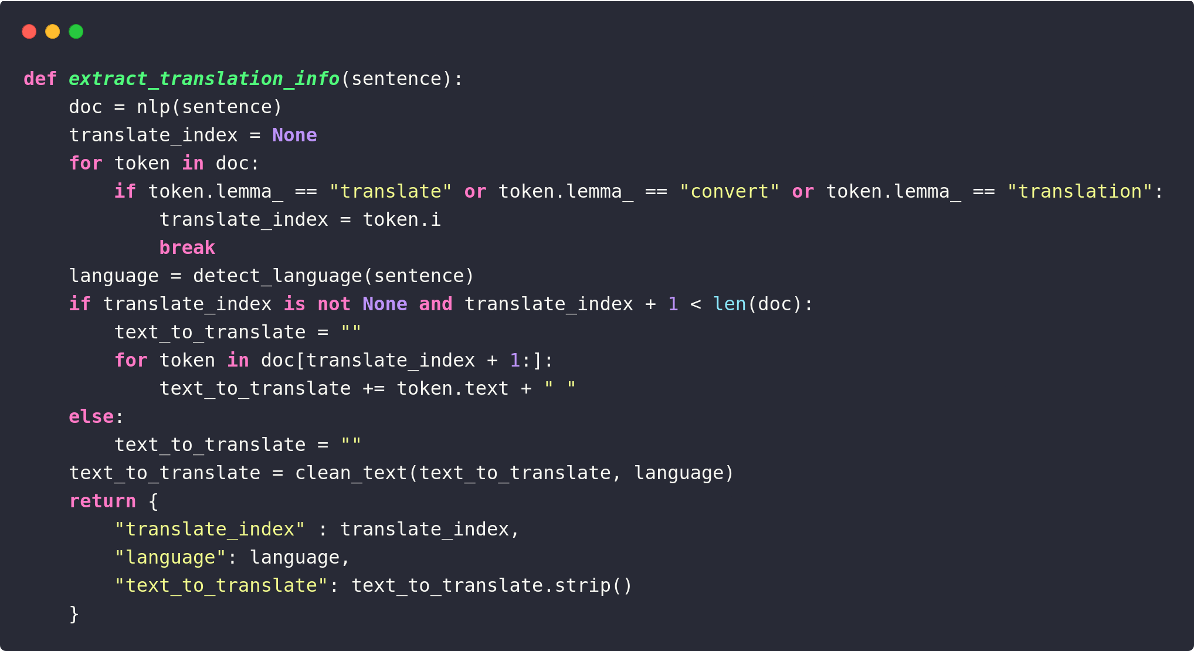
Implementation: speech_indexing.py

Slide 6
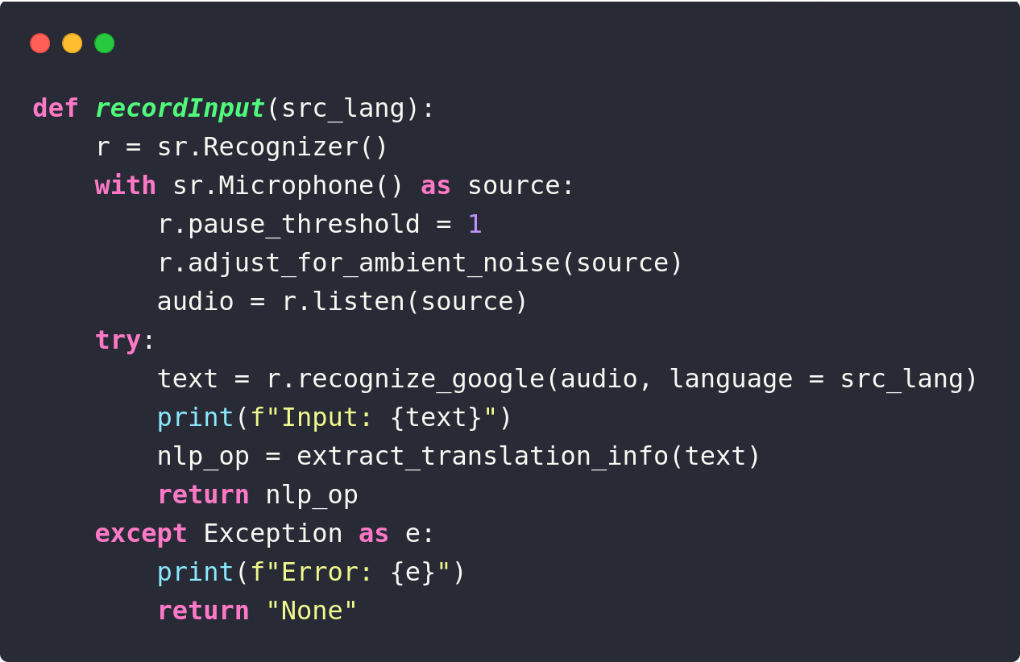
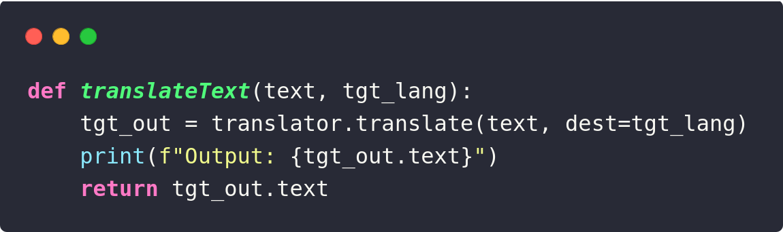
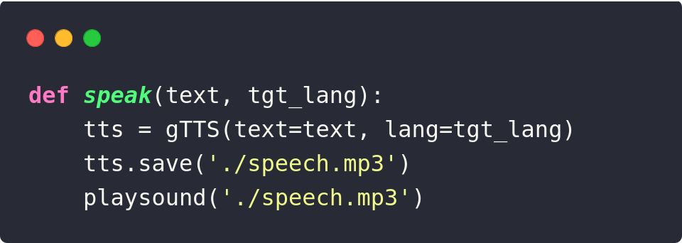
Implementation: main.py

Slide 7

Aims and Objectives
To develop a robust system that can accurately recognize and transcribe spoken language.
To implement a language detection mechanism that identifies the target language for translation.
To evaluate the system's performance across different languages and use cases.

Slide 8
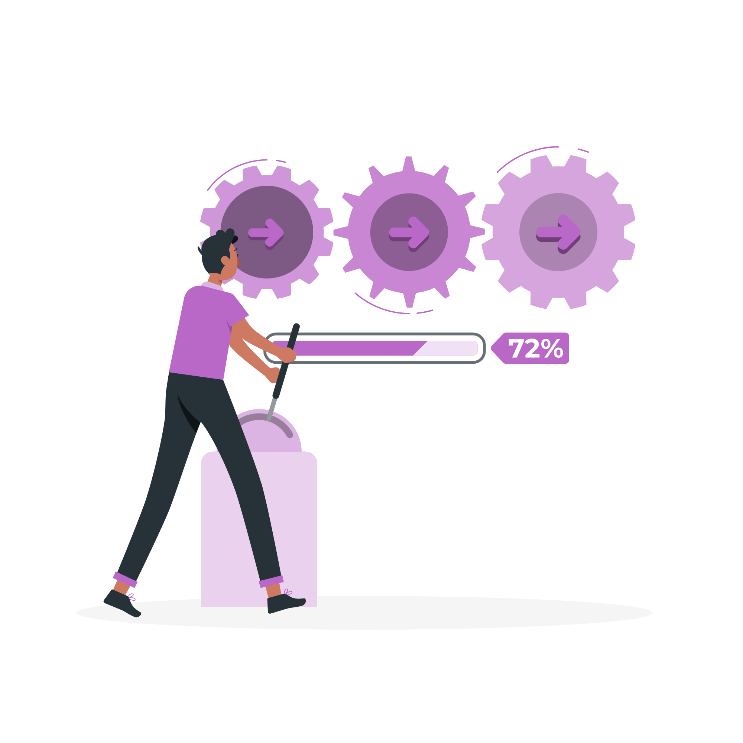
Future Work
To develop an Android app for the user interface.
Increase accuracy by applying noise reduction techniques.
Develop APIs for seamless application integrations.
Testing with offline models for translation and speech recognition.

Slide 9
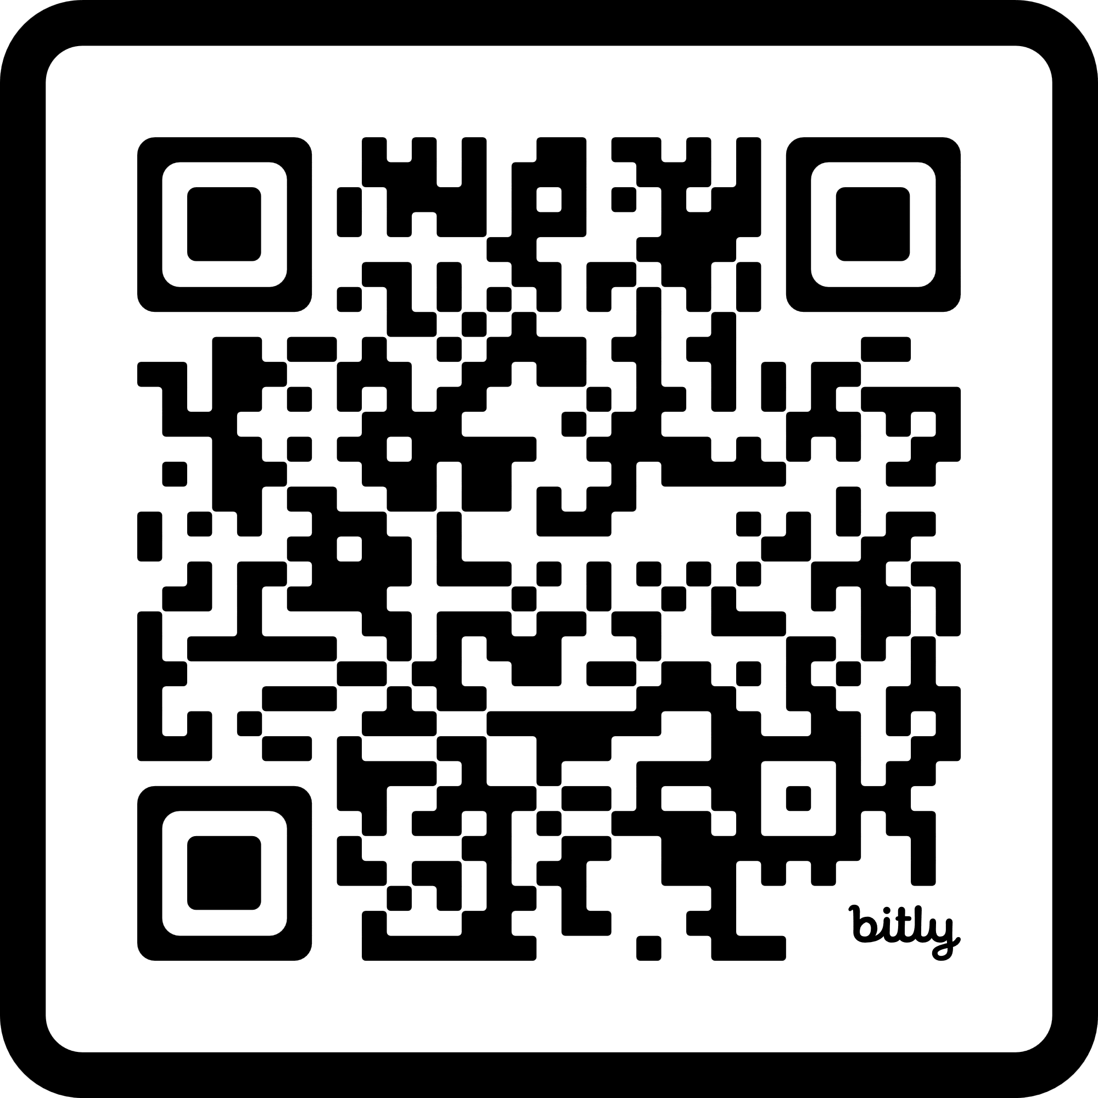
Thank You!
Got any questions?
References:
The ATR Multilingual Speech-to-Speech Translation System: https://www.researchgate.net/publication/3457553_The_ATR_Multilingual_Speech-to-Speech_Translation_System
SpaCy: https://spacy.io/usage
Google Text-to-Speech API: https://gtts.readthedocs.io/en/latest/
Google Translation API: https://py-googletrans.readthedocs.io/en/latest/

